Slide 1
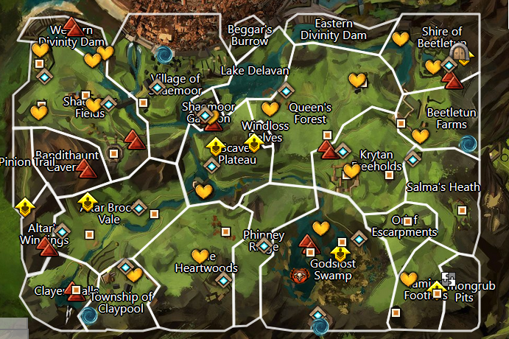
Logan-1-welcome hero- After surviving the centuar attack, go check on the villagers
Faren-2-blasted bandits
Faren-3-dam bandits
Faren-4-Rotten Core
Faren-5-Two in the bush
Faren-6-Dispicable business - Introduce bandits and introduce them to plot linked to cadicus, kidnapping people to sell to centaur.
Faren-7-To shaemoor
Logan-8-Pushing Back- something is attacking the supply road to claymore, go see Lexi
Logan-9-Lost Trade-escort traders along route and check on bar curtis ranch
Logan-10-arnt you harpy-kill harpies and bandits attacking ranch and send news to claypool.
Logan-11-Time for a trade-head down to claypool while logan reports back to queen
Faren-12-trouble of the heart-train in claypool and pickup crafting, fight though the heartwoods
Faren-13-something stinks in queensdale- Head to the ridge and see if its centaur or something dead
Faren-14-Not the beer!- Centuar are attacking the beer! Save the beer
Faren-15-Somethings a buzz-go check on the lumber mill in queens forest, find infestation of skritt,
Faren-16-Vipers Den-they couldn’t be responsible for the kidnapping root out the bandits hideout which “contains” notes about an attack on beetletun
Faren-17-Faint Façade-Find a clue for instructions to pass information on Seraph patrols and attacks on Beetletun
Logan-18-Ministers and Queens – Logan gives a brief on the tension between Cadecus and Jenna. See if the townsfolk know anything about an attack
Logan-19-Hero’s Rescue-after reporting to beetletun, take the attack down to free slaves
Logan-20-Into the foothills-and then to the heart of the centuars in queensdale.
Logan-21- Just the pits-find a “note” about someone escaping into demongrub pits.
Faren-22-A shadow over Queensdale-find survivors “remains” with a note about the centaur using preying on survivors of the demon attacks in godslost swamp.
Logan-23- assault the demon of the swamp and report to swamplost.
Logan-24-Uncover how bandits have been using the cover of the demon to sneak people in and out of queensdale
17
18
4
3
1
19
2
16
5
8
7
6
15
2
9
11
20
10
14
23
13
21
22
12
24

Slide 2
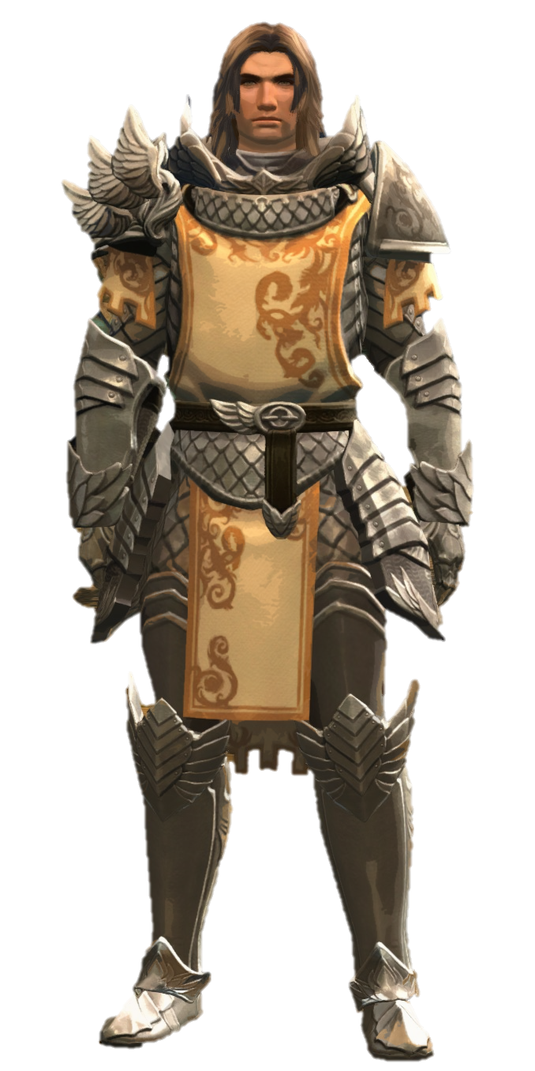

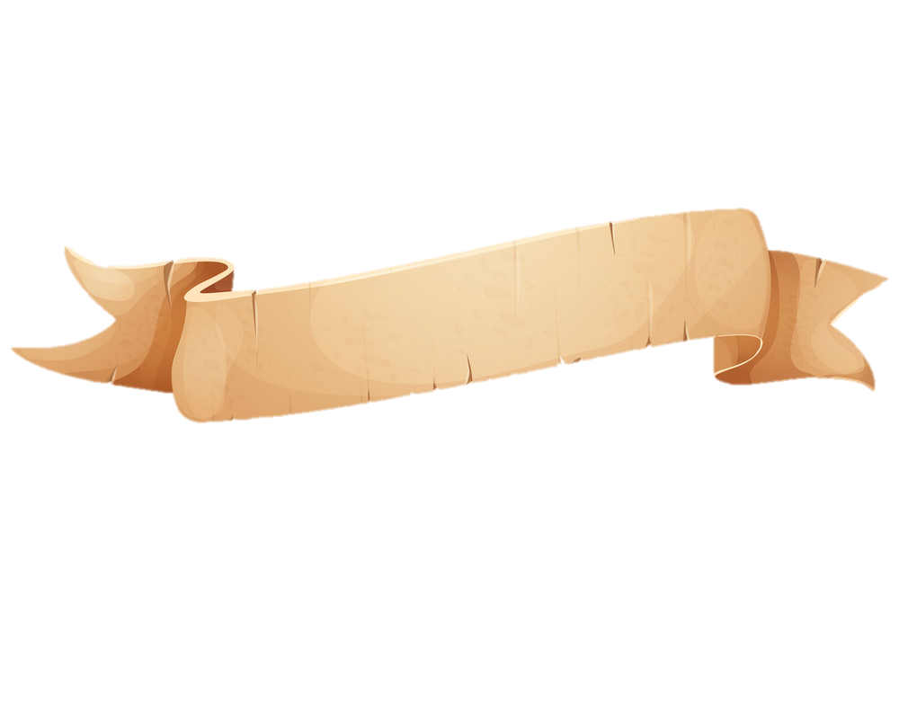
Welcome back to the world of the waking! Glad you helped us at the garrison with the centaur attack. If you’re looking to stretch your legs, can you go with Faren and check on fields? Follow the road and head over to the windmill.
1
Logan

Slide 3
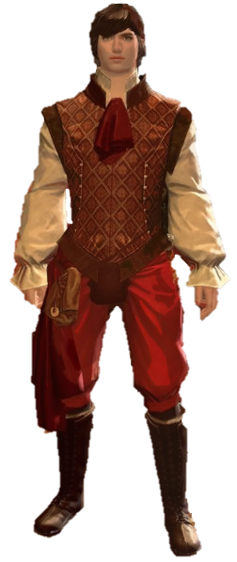
Well, if it isn’t the new “hero”. I hope that knock to your head didn’t do any permanent damage. Logan asked me to come help out but…I’ve been distracted watching that beautiful woman. She is in quite the “Diah-lema”, but I didn’t bring my working clothes. Help her out and come find me by the river.
Somehow its always bandits and this close to home. Let’s check on Flannum and make sure they haven’t done any “dam-age”. Alright, alright, I’ll stop.
You check the north side, and I’ll check the south. Meet you at the western shore.
3
2
Faren

Slide 4
No sign of bandits? Drat, I was hoping to show them what I’m made of. Oh well…the search continues.
Let’s head south, passing through the orchard. I hope we don’t find anything rotten.
This fair maiden has been telling me about her precious moa’s, taken by bandits. While we were…*looking* in the bushes…I found a collar. NO, not one for a moa, but one sized for a human. I’ve got a bad feeling but lets check inside the cave. I hope I’m wrong.
4
5

Slide 5
This is terrible! These bandits are slave traders! The populace of Divinity’s Reach is under threat and *we* must bring this devious act to light. Shall we follow that tunnel out and see were these villains reside?
What a poor excuse for a door… just a hole...in a WALL. It is however, right near the pump station. Makes sense why it keeps having issues. This slew of depravity as soiled my spirit and clothes. I’m going check on my father's shipment and you need to inform Logan. He’s at the garrison to the east.
6
7

Slide 6
Slave collars and cages, by the nine… Jennah...I mean the queen, won’t be happy to hear this. I’m also concerned about these centaur attacks. Let’s see if we can push them back and buy us some room to think. Reclaim the plateau and meet me by the trading post.
I hope you showed them no mercy. Lexi just finished telling me about how difficult it’s been to get supplies. Shall we help clear the road? We need to check on the Bar Curtis Ranch, past the Altar Brook bridge.
8
9

Slide 7
Looks like those bandits have also found a way out on this side of the mountain. On top of that Curtis keeps petitioning the Seraph for a “harpy defense force”. I guess we are it today.
Let’s head into the western hills and put some birdbrains to sword.
*breathing heavily* Whew…this hero thing might actually be your calling.
That or you are one unlucky person with skills to back it up.
Let’s head back and take a break at the township of Claypool.
10
11

Slide 8
I need to head back to my duties and give the Queen an update on the bandits and centaur attacks. I heard from the guards that your friend Lord Faren had recently departed out the hidden exit to the east.
That is towards the Heartwoods, a troublesome spot.
They dare disrupt my shipment of silk underwear. What? How else is one supposed to flaunt their wealth!? Thanks for helping recover my *cough* supplies, but ugh, the stench here is horrible. Let’s head to the ridge for some fresh air.
13
12

Slide 9
Well, I think it smells worse here then back in that pigsty those hoofed buffoons were using. That swamp is terrifying, lets avoid it for now, but
I do know a good place to get a refreshing drink.
Can we head to the Eldvin Monastery?
First my silk, and now the BEER? These centaur have committed the most heinous of crimes! With this pattern my new armoire might be under attack… and of course, the people.
Let’s head north to the lumbermill.
14
15

Slide 10
These bloody RATS. Well at least its not centaur or bandits. Wait WHATTT, bandits have been spotted across the lake? Let’s head over and see if they are connected to those cursed slave traders.
I can’t believe there is a bandits den so close to Divinity’s Reach. And look here…someone left their ledgers on the table. Ohh my...please go find Logan. One of the lumbermill workers said he was headed east towards Beetletun.
16
17

Slide 11
Deny me entry? The nerve of that captain, no respect for the Seraph. But I guess bandit slavers and attacking centaurs are of no concern for ministers in their ivory towers.
Let’s head down to the main gate.
Check around town, but these Seraph guards mentioned an issue in the south. At least someone knows who really makes up the heart of Kryta. When you finish, head down to Salma’s Heath and find me?
18
19

Slide 12
This is disgusting…hidden right under our noses. How did these centaur get so many slaves so quickly. Let’s see if we can find their leadership cut the off its head!
The slaves mentioned an encampment further south.
Good riddance. I hope that slows them down until we can better understand what's going on. The chieftain had a note about escaped slaves in the pits.
Look in the Demongrub Pits and see if we can find any survivors.
20
21

Slide 13
No blasted survivor
*sigh* …those oozes will eat about anything. You get anything good from the chest? Only thing I needed was this parchment. It’s mostly ruined except for this “…under the shadow of the swamp we were moved”
Quickly! To Godslost Swamp.
This place is foul. Shall we banish this “shadow” of the swamp.
Defeat the shadow of the swamp and regroup at Swamplost Haven.
23
22

Slide 14
A bloody behemoth demon?!? That would be a large enough distraction to smuggle slaves in any event. I’ll need to report this to Jen…the queen. Please, proceed into Kessex Hills and see if you can find the trail of these smugglers.
24-End

Slide 15
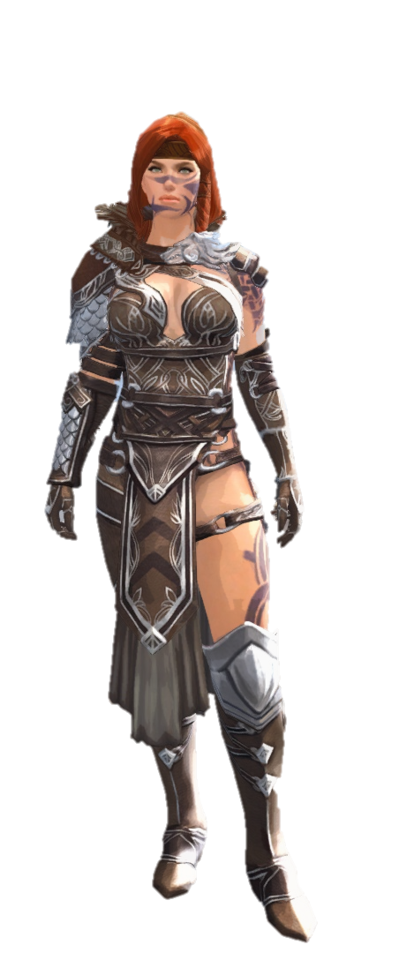
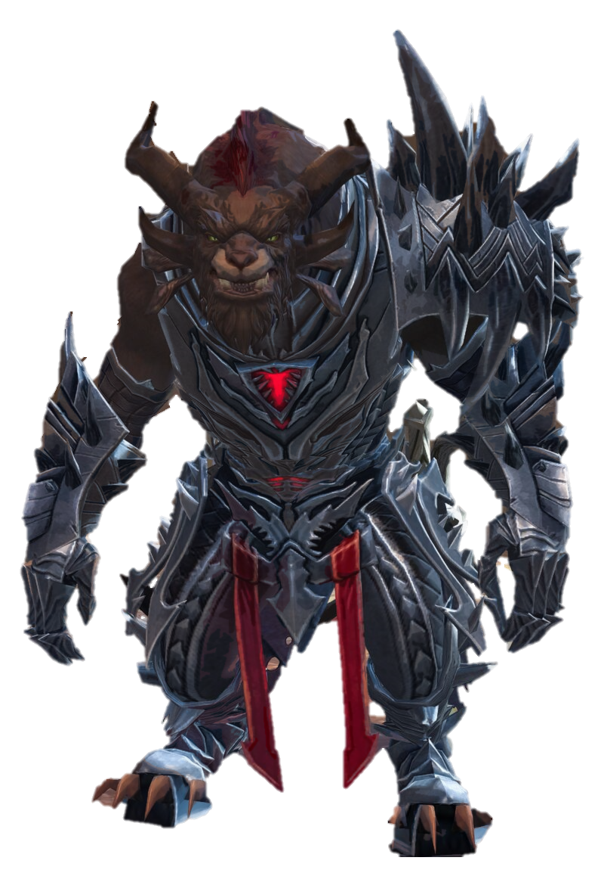
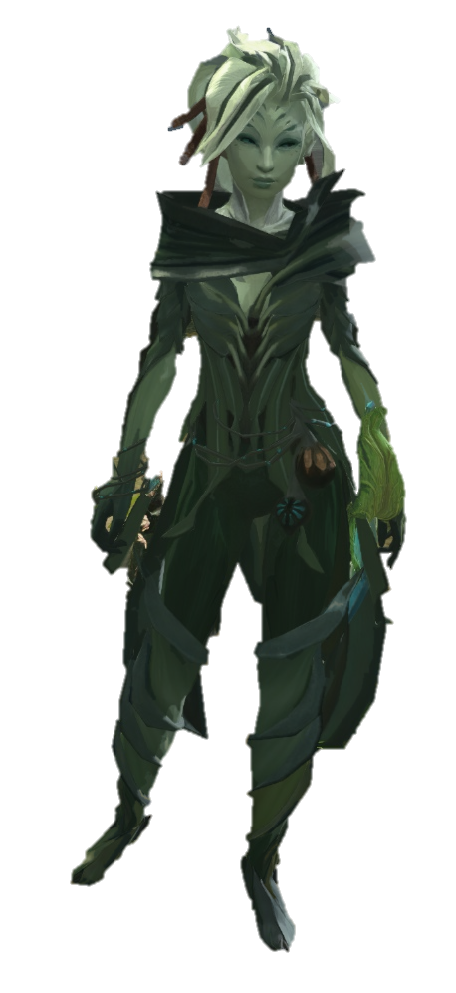
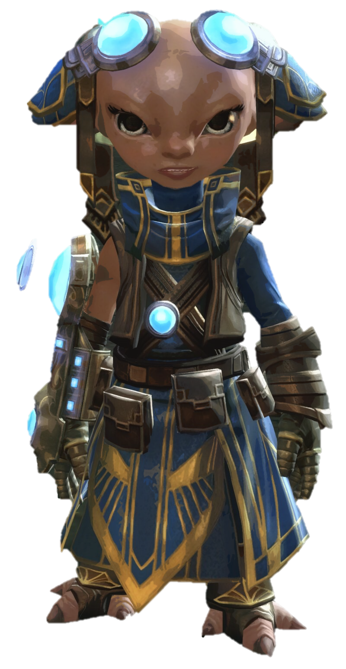

Slide 16
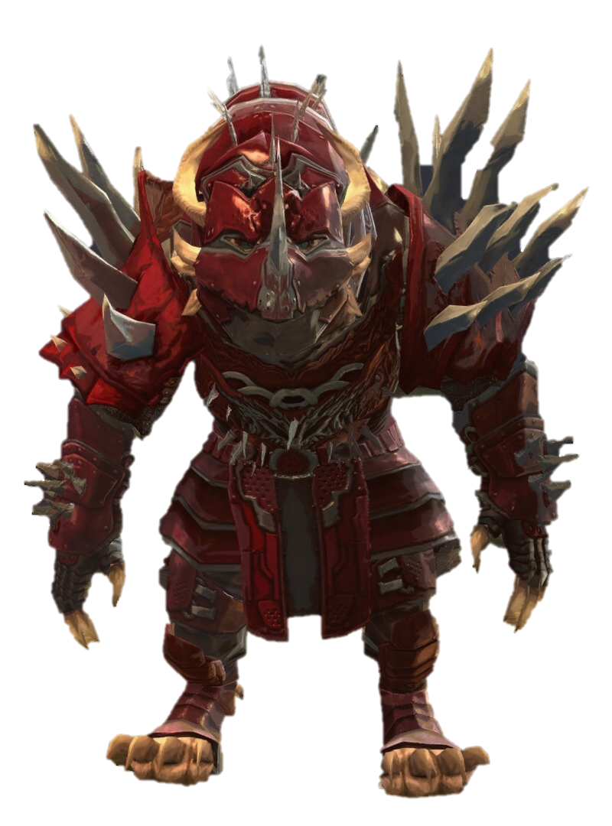

Slide 18
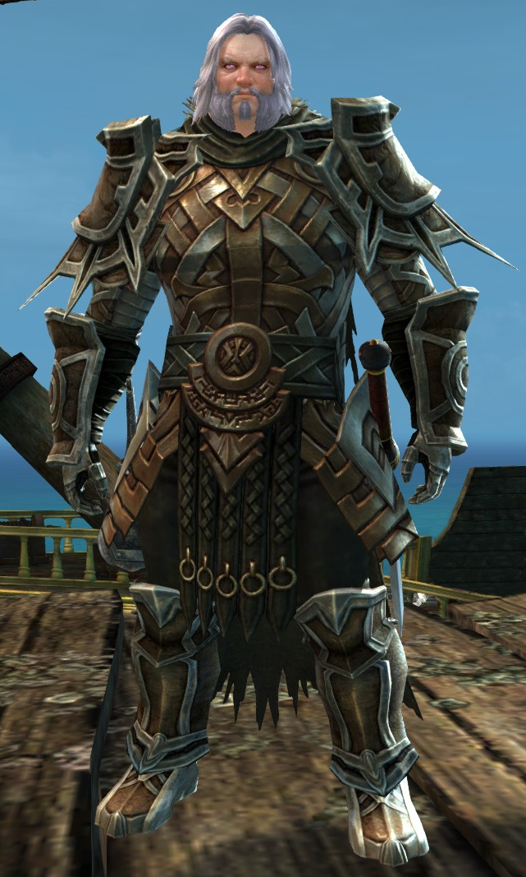
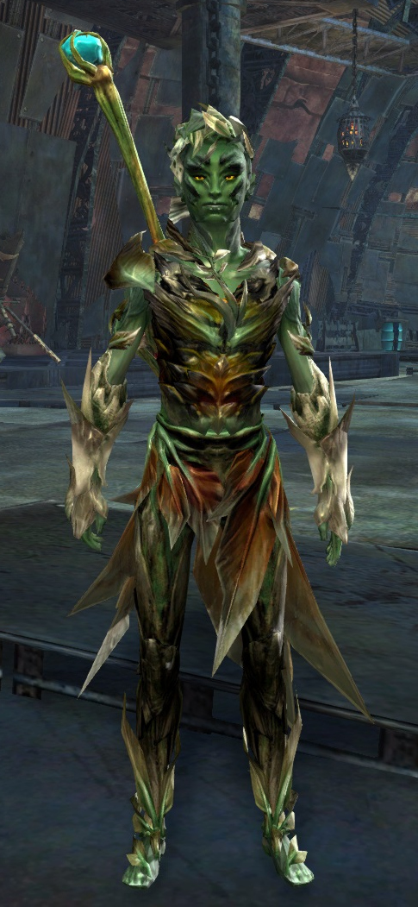
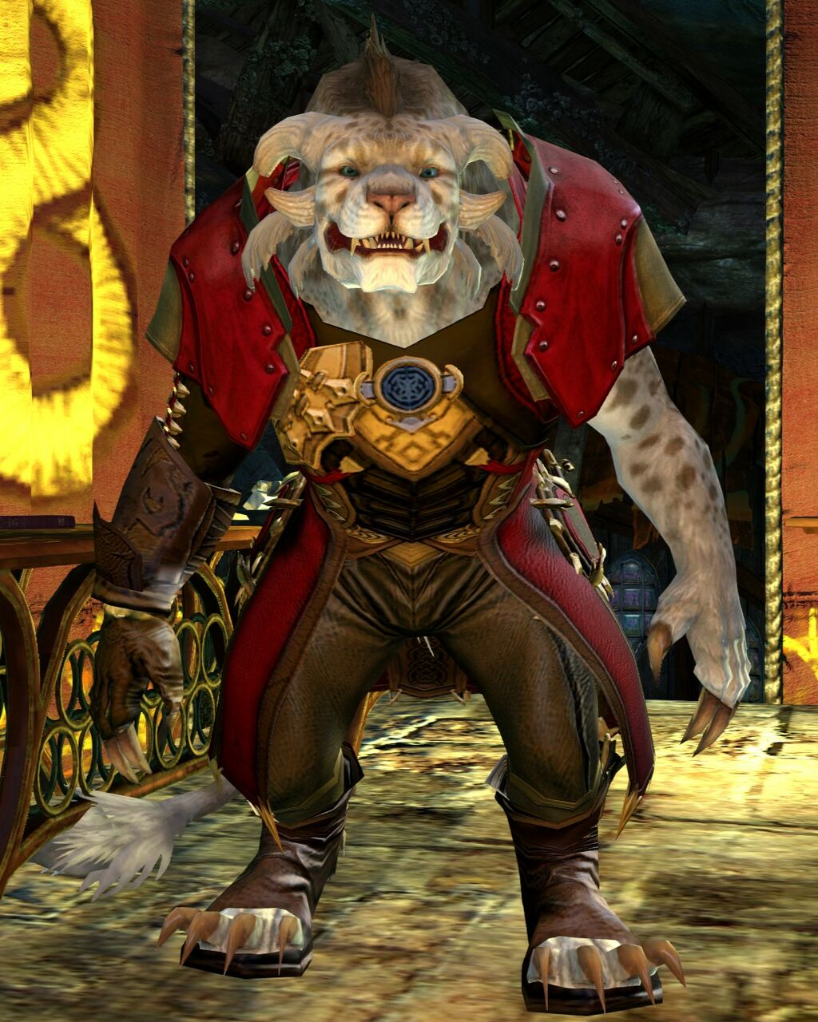
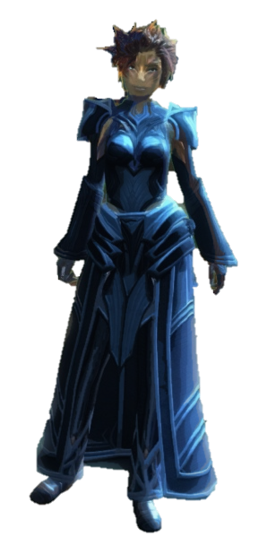

Slide 19
